Slide 1

SCC331 group 5 (super coders) user testing
SPRINT 4

Slide 2
REASONS FOR OUR RESEARCH
We are thrilled to share the findings from our user testing research for the webpage for scc311 group 5 project. This webpage was created with the intention of giving users a smooth and entertaining experience while monitoring where people are in the prison , number of people in each building and environmental changes e.g temperature. The webpage will also make charts and stats on the environmental changes as an extra functionality

Slide 3

Research findings:
We gathered 5 participants who had no involvement in the development and previous use of the webpage . They were instructed to use the webpage and answer 10 questions and are give 5 option in order for us to draw our conclusions.

Slide 4
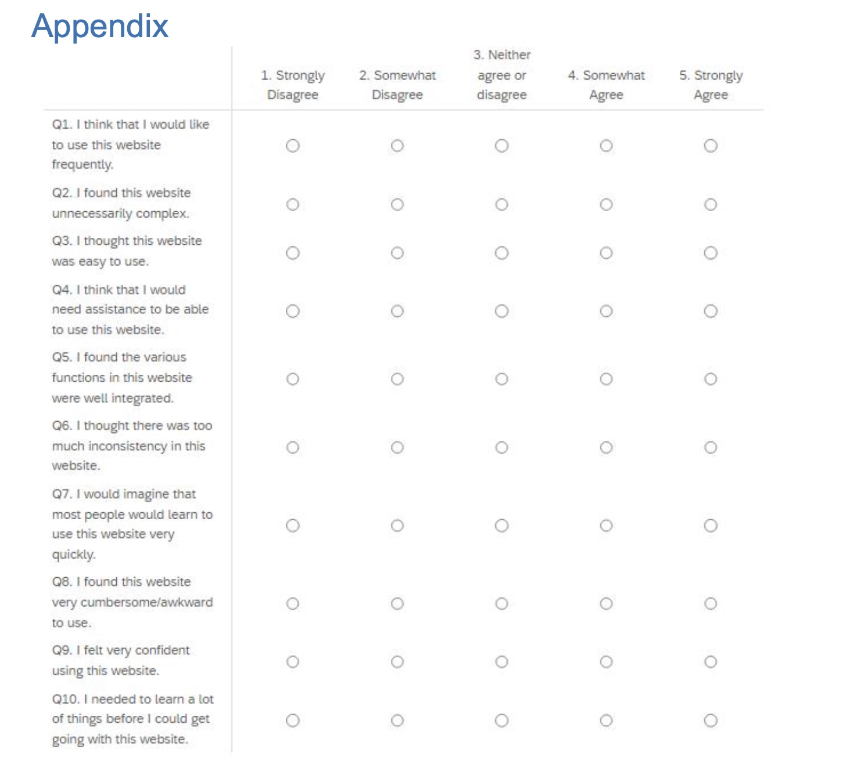

Slide 5
USER ANSWERS
 | USER 1 | USER 2 | USER 3 | USER 4 | USER 5 | AVERAGE(ROUNDED)
QUESTION 1 | 3 | 5 | 4 | 5 | 4 | 4
QUESTION 2 | 3 | 2 | 2 | 1 | 2 | 2
QUESTION 3 | 4 | 5 | 3 | 5 | 5 | 4
QUESTION 4 | 1 | 2 | 1 | 1 | 2 | 1
QUESTION 5 | 4 | 5 | 5 | 4 | 5 | 5
QUESTION 6 | 1 | 1 | 2 | 1 | 2 | 1
QUESTION 7 | 4 | 3 | 4 | 5 | 5 | 4
QUESTION 8 | 1 | 2 | 2 | 2 | 1 | 2
QUESTION 9 | 3 | 4 | 5 | 5 | 4 | 4
QUESTION 10 | 1 | 1 | 2 | 1 | 1 | 1

Slide 6
USER QUESTION RATINGS

Slide 7

CONCLUSION
We have obtained insightful information from a thorough round of user testing on the group 5 webpage that will greatly improve the user experience as a whole. Numerous factors were taken into consideration throughout the review, such as usability, task success, time spent on task, error rates, and user happiness.
The majority of participants said that the website's navigation, design, and layout were user-friendly and were satisfied with the webpage. They all rated it highly
The results of this user testing will be utilized to establish priorities and carry out the required enhancements. In order to exceed customer expectations and provide a remarkable user experience, we are dedicated to improving the super coders(group 5) webpage. Additional testing, continuing feedback integration, and design modifications are all part of the iterative process.
We appreciate the significant contributions from all participants and users, such as testers and prison officers, and look forward to incorporating these modifications to make the Super Coders webpage an even better platform for our users.

